Slide 1

Low energy ELEctron driven chemistry
for the advantage of emerging NAno-fabrication methods

Slide 2





















@ ELENA Training Network, www.elena-eu.org

Slide 3
  The Objective
To provide a full understanding of the role of low energy (0-100 eV) secondary electrons in preparing specific reaction products to induce controlled chemistry in FEBID and EUVL substrates.
Create nanosurfaces that could reduce the bacteria and virus spread.
Offer tools to analyze molecular compounds, proteins, their deposition on complex surfaces.

Slide 4
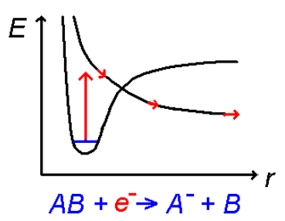
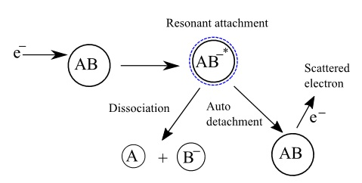
AB + e- → (AB)- * → A- + B
DEA
or Dissociative Electron Attachment is the process of dissociation of molecules in two stable fragments after passing from a vibrational ground state to a ionized higher energy temporary state.
Facts:
Protons are RED
Electrons are Blue
Neutrons are Green

Slide 5
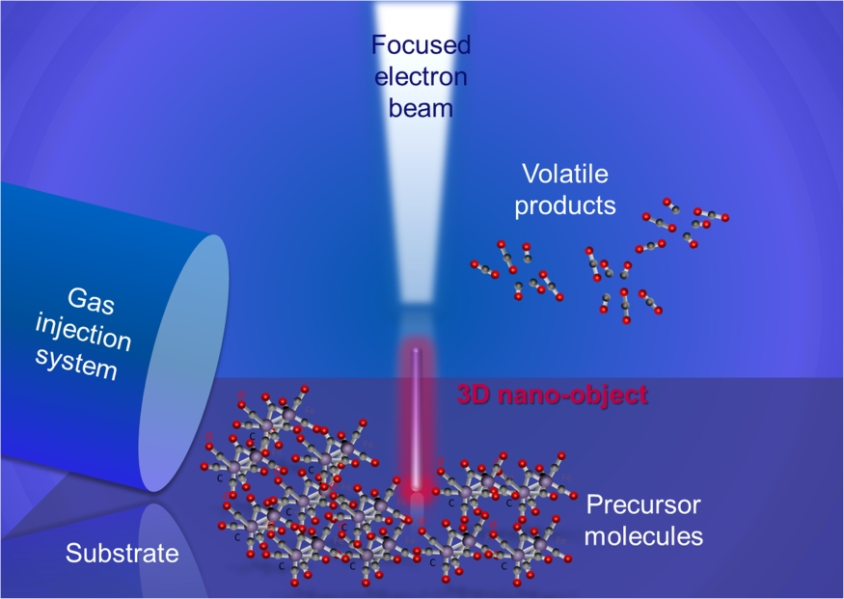
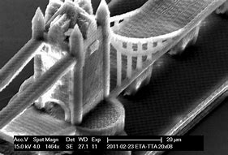
FEBID
Focused Electron
Beam Induced
Deposition
* nanotechweb.org

Slide 6
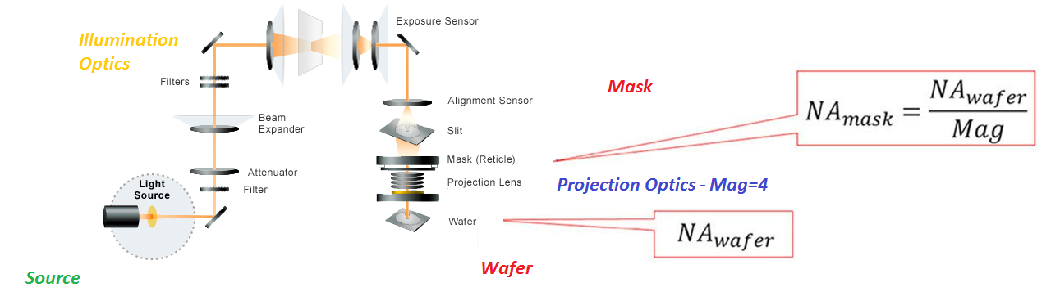
EUVL – Extreme Ultraviolet Lithography
*spie.org
* anandtech.com

Slide 7
VMI or Velocity Map Imaging Technique
is an experimental technique for making measurements of the velocity of product molecules or particles following a chemical reaction or the photo-dissociation of a parent molecule involving a DEA process.

Slide 8
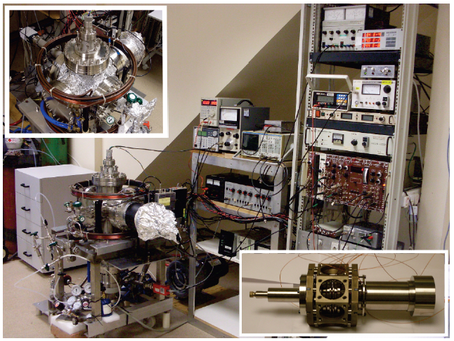
Velocity Map Imaging Equipment
Helmholtz Coils
Control Modules
Electron Gun

Slide 9
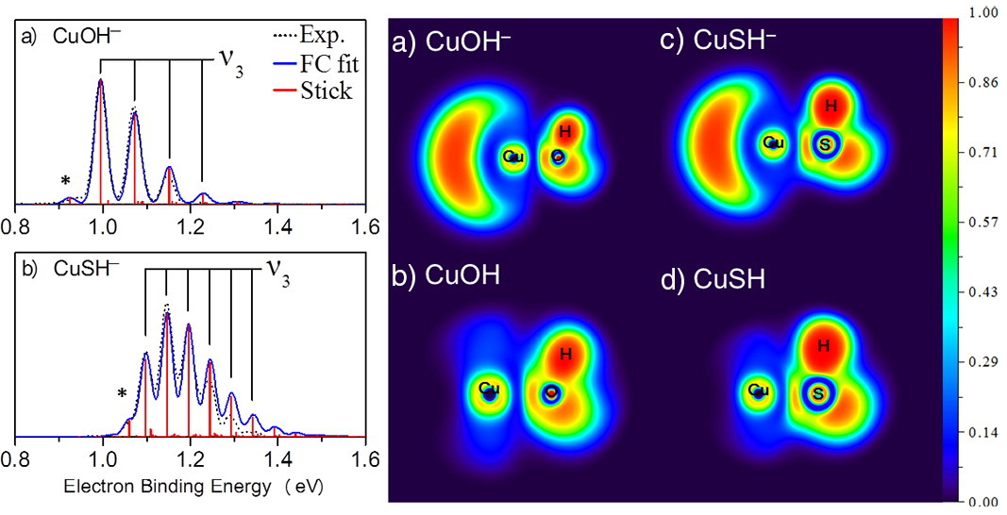
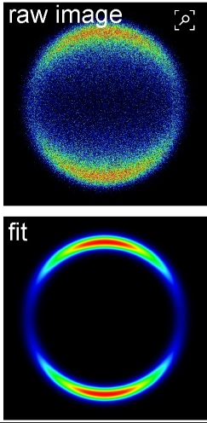
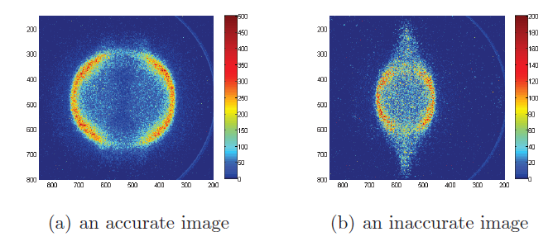
Fig1. Velocity map imaging for CuXH- (X = O and S).
“Electron velocity map imaging and theoretical study on CuXH (X = O and S) anions”,
Qin, Zhengbo ; Wang, Hui ; Ren, Yangdi ; Zheng, Xianfeng ; Cui, Zhifeng ; Tang, Zichao;
Spectrochimica Acta Part A: Molecular and Biomolecular Spectroscopy, 5 January 2018, Vol.188, pp.85-89 [Peer Reviewed Journal]
Fig2b. Fakultät für Chemie und Pharmazie
Institut für Physikalische und Theoretische Chemie Lehrstuhl für Physikalische Chemie;
Research: “Molecular Spectroscopy and Photochemistry of Isolated Cold Molecules in the Gas Phase”
Fig2a. Velocity map imaging for O-/O2 at 6.5 eV without fit.

Slide 10
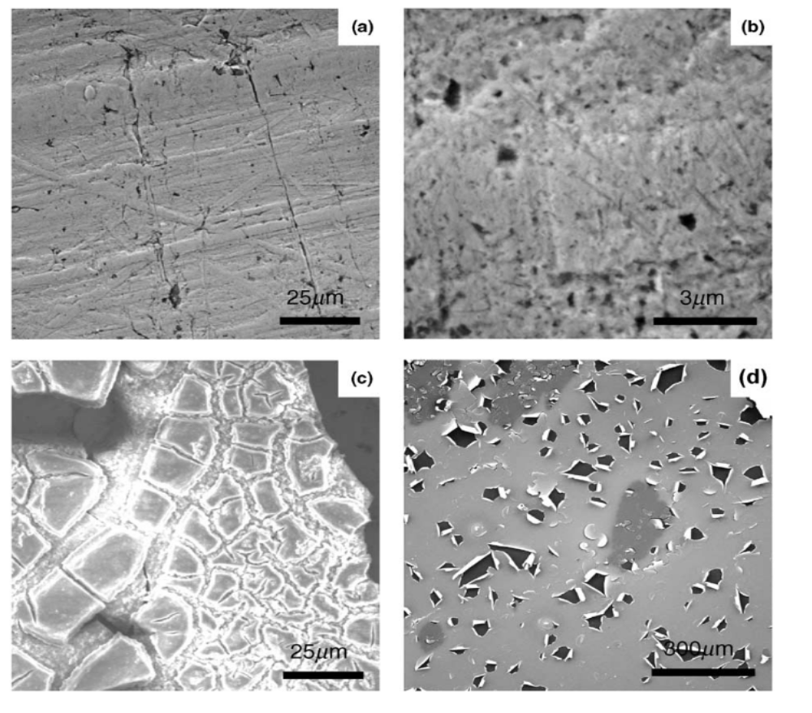
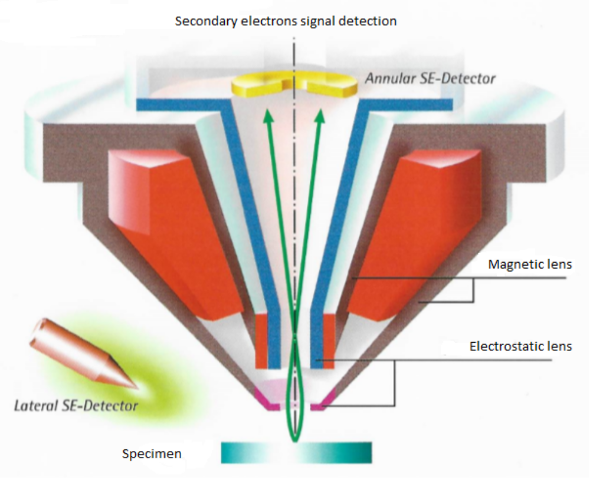
FEBID – using SIMS, TEM and GIS systems for deposition
Four substrates with thin films of TEOS depositions. (a) and (b) thiol-functionalized silica film electrogenerated on gold (c) nonfunctionalized silica film electrogenerated on gold from pure TEOS (d) silica sol-gel film spin-casted on glassy carbon electrode.

Slide 11
www.elena-eu.org

